Slide 1

Linux Basic

Slide 2







Linux basic
LINUX INTRODUCE
HOW TO INSTALL (UBUNTU SERVER)
SHELL COMMAND

Slide 3

I. Linux introduce
What is Linux
Linux is an Unix-like computer operating system assembled under the model of free and open-source software development and distribution.
These operating systems share the Linux kernel and typically have the GNU utilities.
Linux comes in several distributions to serve different purposes.

Slide 4
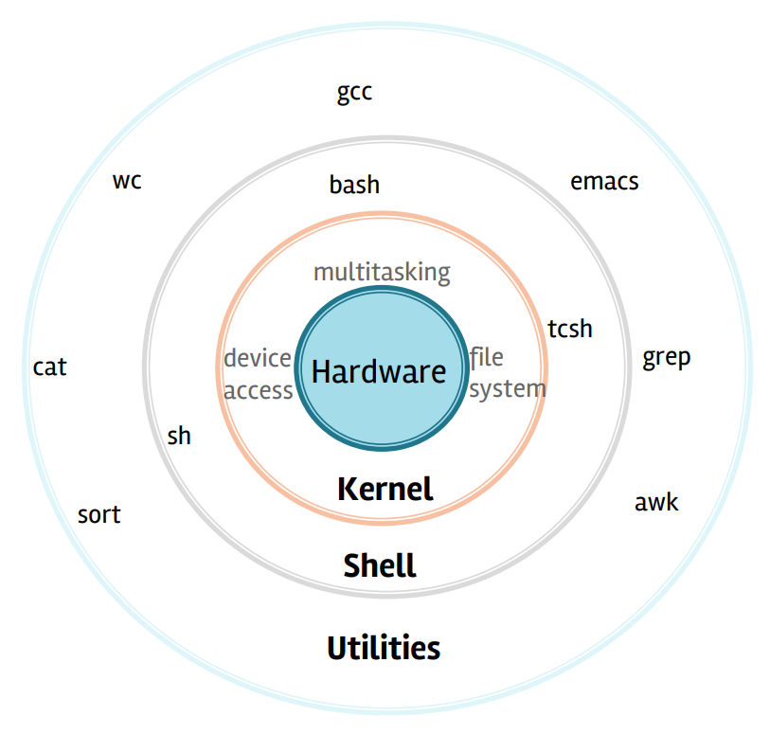
I. Linux introduce
The kernel facilitates required abstraction for hiding details of low-level hardware or application programs to the system. There are some of the important kernel types which are mentioned below:
Linux architecture:
Kernel: Facilitates required abstraction for hiding details of low-level hardware or application programs to the system. Some important kernel types are: monolithic, micro, exo and hybrid kernel
Shell: It is an interface among the kernel and user. It can take commands through the user and runs the functions of the kernel. The shells are categorized into two different types: graphical shells and command-line shells.
Utility programs: A system utility program performs specific and individual jobs.

Slide 5
I. Linux introduce
Linux features
The kernel facilitates required abstraction for hiding details of low-level hardware or application programs to the system. There are some of the important kernel types which are mentioned below:
Open source: Users can modify Linux thanks to its open-source license.
Multi-user environment: It is a multi-user-friendly system. This means that more than one user can access system resources (memory, hard disk, etc.) at the same time through different terminals.
Multitasking: Multiple applications can be run at the same time.
Security: Linux is a highly secure system. Once a user installs Linux, there is no need to install and maintain antivirus software. Linux can become more robust and secure with updates. In addition, it provides secure features such as authentication, authorization, and encryption.
GUI (Graphical User Interface): Linux mainly relies on the Command Line Interface (CLI), but there are many Linux distributions that come with GUI support.
File System: It provides a standard file system in which system files and user files are managed.

Slide 6
II. How to install (Ubuntu server)
This section explains various aspects to consider before starting the installation.
The kernel facilitates required abstraction for hiding details of low-level hardware or application programs to the system. There are some of the important kernel types which are mentioned below:
Ubuntu Server Edition provides a common, minimalist base for a variety of server applications, such as file/print services, web hosting, email hosting, etc. This version supports four 64-bit architectures:
amd64 (Intel/AMD 64-bit)
arm64 (64-bit ARM)
ppc64el (POWER8 and POWER9)
s390x (IBM Z and LinuxONE)
The Ubuntu Server Edition and the Desktop Edition use the same apt repositories, making it just as easy to install a server application on the Desktop Edition as on the Server Edition.
One major difference is that the graphical environment used for the Desktop Edition is not installed for the Server. This includes the graphics server itself, the graphical utilities and applications, and the various user-supporting services needed by desktop users.

Slide 7
II. How to install (Ubuntu server)
This section provides an overview of installing Ubuntu Server Edition.
For amd64, download the install image from https://releases.ubuntu.com/20.04/.
There are many ways to boot the installer but the simplest and commonest way is to create a bootable USB stick to boot the system to be installed with (tutorials for other operating systems are also available).
Preparing install media: For amd64, download the install image from https://releases.ubuntu.com/20.04/. There are many ways to boot the installer but the simplest and most commn way is to create a bootable USB to boot the system to be installed with.
Booting the installer:
Plug the USB into the system to be installed and start it.
There should be an on-screen message when the computer starts telling you what key to press for settings or a boot menu. Depending on the manufacturer, this could be Escape, F2, F10 or F12. Simply restart your computer and hold down this key until the boot menu appears, then select the drive with the Ubuntu install media.
Using the installer: The installer is designed to be easy to use and have sensible defaults so for a first install you can mostly just accept the defaults for the most straightforward install. There is more detailed on all the options.

Slide 8
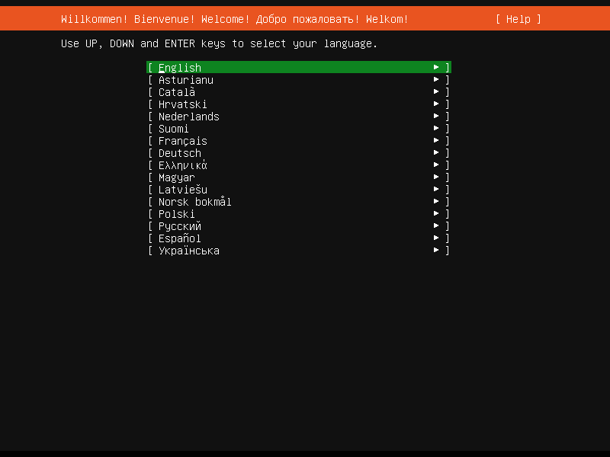
II. How to install (Ubuntu server)
Using the installer step by step
For amd64, download the install image from https://releases.ubuntu.com/20.04/.
There are many ways to boot the installer but the simplest and commonest way is to create a bootable USB stick to boot the system to be installed with (tutorials for other operating systems are also available).
Language selection: This screen selects the language for the installer and the default language for the installed system.

Slide 9
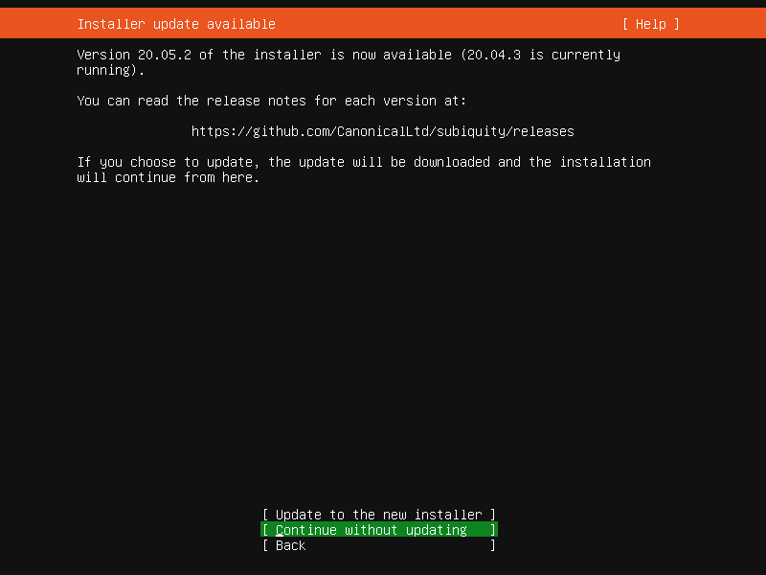
II. How to install (Ubuntu server)
Using the installer step by step
For amd64, download the install image from https://releases.ubuntu.com/20.04/.
There are many ways to boot the installer but the simplest and commonest way is to create a bootable USB stick to boot the system to be installed with (tutorials for other operating systems are also available).
Refresh: This screen is shown if there is an update for the installer available. This allows you to get improvements and bug fixes made since release. If you choose to update, the new version will be downloaded and the installer will restart at the same point of the installation.

Slide 10
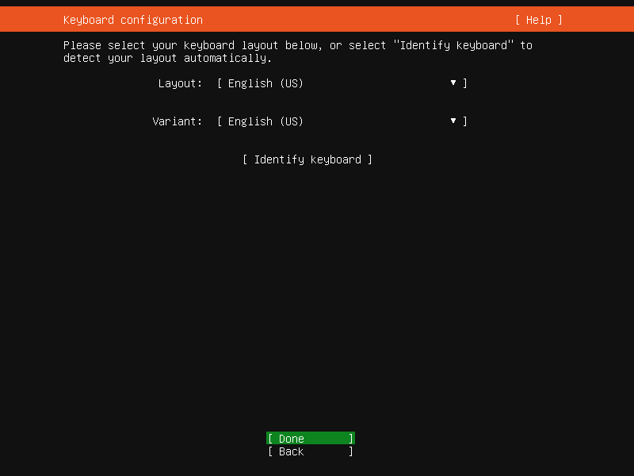
II. How to install (Ubuntu server)
Using the installer step by step
For amd64, download the install image from https://releases.ubuntu.com/20.04/.
There are many ways to boot the installer but the simplest and commonest way is to create a bootable USB stick to boot the system to be installed with (tutorials for other operating systems are also available).
Keyboard: Choose the layout and variant of keyboard attached to the system, if any. When running in a virtual terminal, it is possible to guess the layout and variant by answering questions about the keyboard.

Slide 11
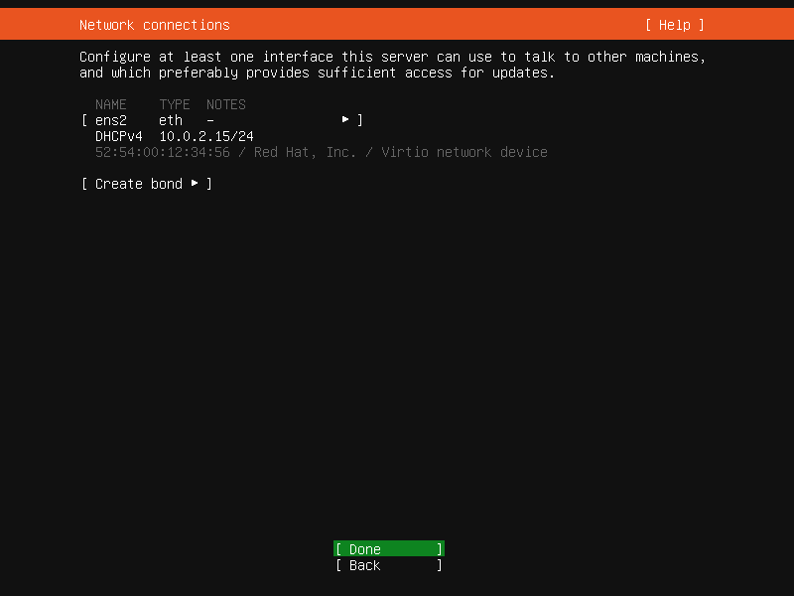
II. How to install (Ubuntu server)
Using the installer step by step
For amd64, download the install image from https://releases.ubuntu.com/20.04/.
There are many ways to boot the installer but the simplest and commonest way is to create a bootable USB stick to boot the system to be installed with (tutorials for other operating systems are also available).
Network: This screen allows the configuration of the network. Ubuntu Server uses netplan to configure networking and the UI of the installer can configure a subset of netplan’s capabilities. In particular it can configure DHCP or static addressing, VLANs and bonds. If networking is present (defined as “at least one interface has a default route”) then the installer will install updates from the archive at the end of installation.

Slide 12
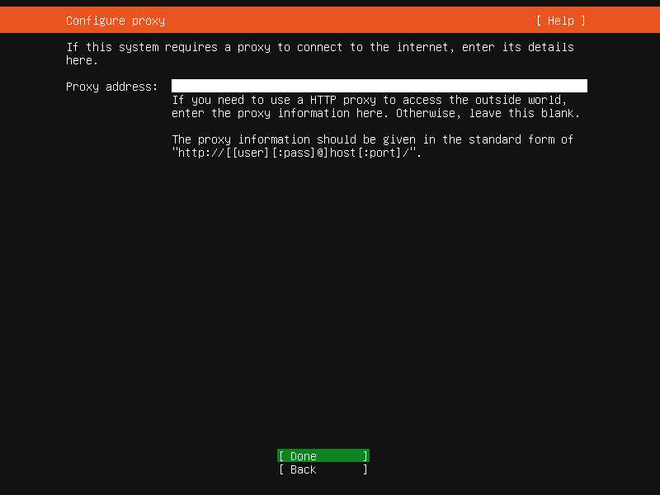
II. How to install (Ubuntu server)
Using the installer step by step
The proxy configured on this screen is used for accessing the package repository and the snap store both in the installer environment and in the installed system.
Proxy: The proxy configured on this screen is used for accessing the package repository and the snap store both in the installer environment and in the installed system.

Slide 13
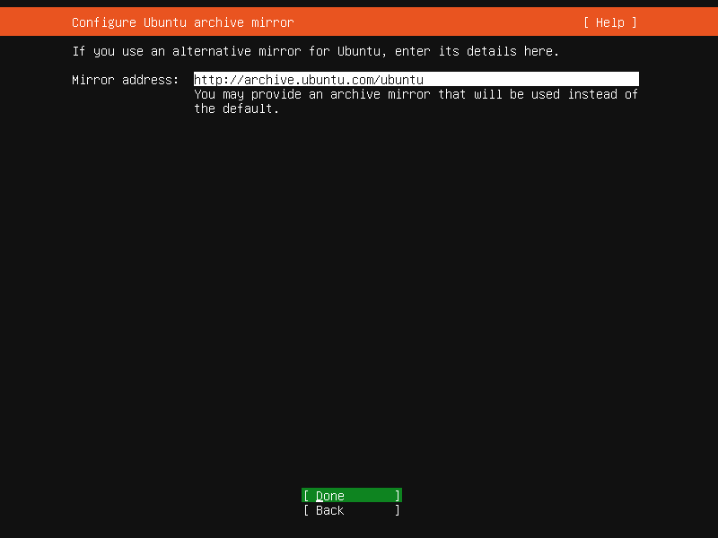
II. How to install (Ubuntu server)
Using the installer step by step
The proxy configured on this screen is used for accessing the package repository and the snap store both in the installer environment and in the installed system.
Mirror: The installer will attempt to use geoip to look up an appropriate default package mirror for your location. If you want or need to use a different mirror, enter its URL here.

Slide 14
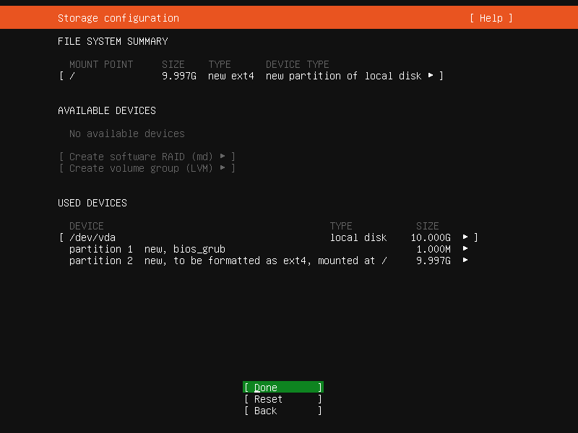
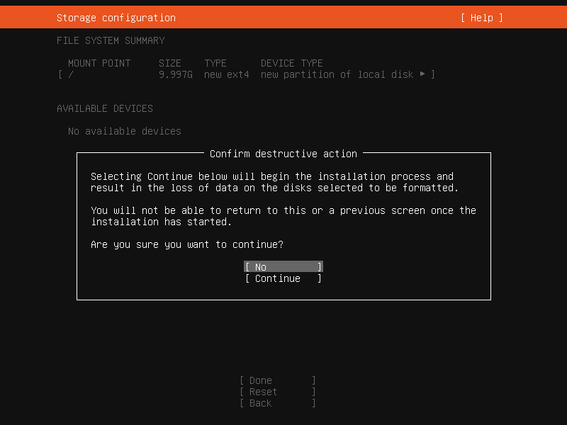
II. How to install (Ubuntu server)
Using the installer step by step
The proxy configured on this screen is used for accessing the package repository and the snap store both in the installer environment and in the installed system.
Storage: Once the storage configuration is confirmed, the install begins in the background.

Slide 15
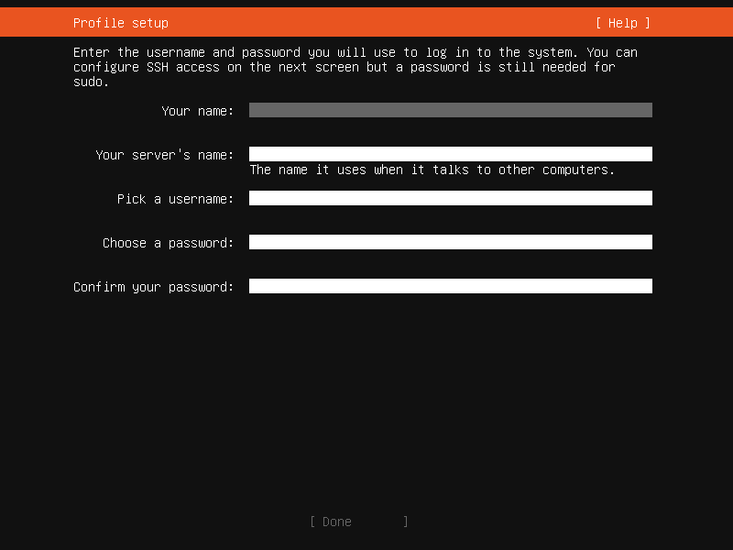
II. How to install (Ubuntu server)
Using the installer step by step
The proxy configured on this screen is used for accessing the package repository and the snap store both in the installer environment and in the installed system.
Identity: The default user will be an administrator, able to use sudo (this is why a password is needed, even if SSH public key access is enabled on the next screen).

Slide 16
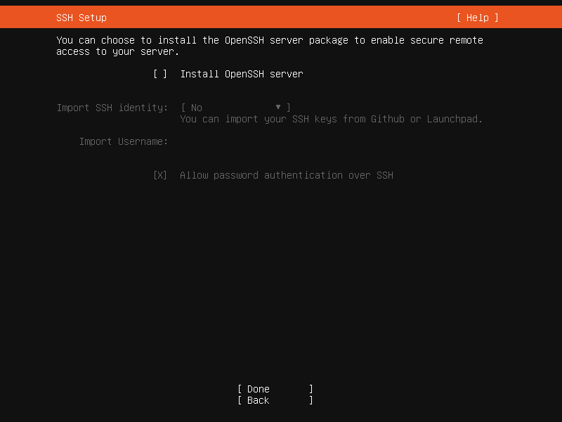
II. How to install (Ubuntu server)
Using the installer step by step
The proxy configured on this screen is used for accessing the package repository and the snap store both in the installer environment and in the installed system.
SSH: A default install has no open ports. It is very common to administer servers via SSH so the installer allows it to be installed with the click of a button. You can import keys for the default user from Github or Launchpad. If you import a key, password authentication is disabled by default but it can be re-enabled again if you wish.

Slide 17
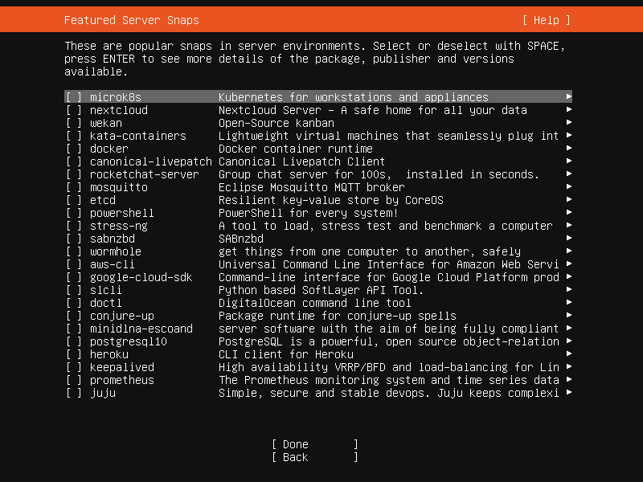
II. How to install (Ubuntu server)
Using the installer step by step
The proxy configured on this screen is used for accessing the package repository and the snap store both in the installer environment and in the installed system.
Snaps: If a network connection is enabled, a selection of snaps that are useful in a server environment are presented and can be selected for installation.

Slide 18
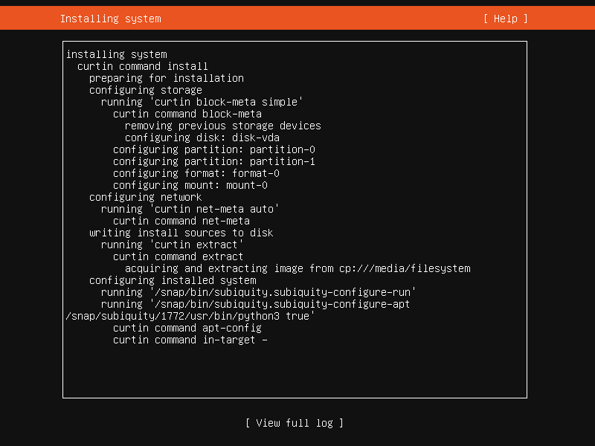
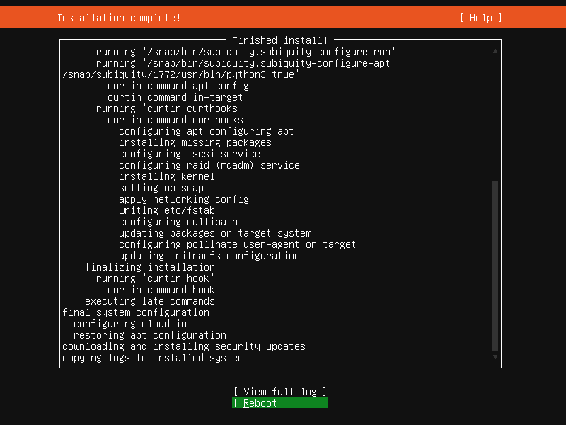
II. How to install (Ubuntu server)
Using the installer step by step
The proxy configured on this screen is used for accessing the package repository and the snap store both in the installer environment and in the installed system.
Installation logs: The final screen of the installer shows the progress of the installer and allows viewing of the full log file. Once the install has completed and security updates installed, the installer waits for confirmation before restarting.

Slide 19
III. Shell command
What is a command shell
The proxy configured on this screen is used for accessing the package repository and the snap store both in the installer environment and in the installed system.
A program that interprets commands.
Allows a user to execute commands by typing them manually at a terminal, or automatically in programs called shell scripts.
A shell is not an operating system. It is a way to interface with the operating system and run commands.

Slide 20
III. Shell command
Special characters
The proxy configured on this screen is used for accessing the package repository and the snap store both in the installer environment and in the installed system.
It is important to know that there are many symbols and characters that the shell interprets in special ways. This means that certain typed characters:
Cannot be used in certain situations
May be used to perform special operations
Must be “escaped” if want to use them in a normal way.

Slide 21
III. Shell command
Special characters
The proxy configured on this screen is used for accessing the package repository and the snap store both in the installer environment and in the installed system.
Character | Description
\ | Escape character to reference a special character. Example: touch /tmp/filename\*
/ | Directory separator Example: /usr/src/linux
. | Current directory
.. | Parent directory
~ | User’s home directory
* | Represents 0 or more characters in a filename, or by itself, all files in a directory.
? | Represents a single character in a filename.

Slide 22
III. Shell command
Special characters
The proxy configured on this screen is used for accessing the package repository and the snap store both in the installer environment and in the installed system.
Character | Description
| | Pipe character. Redirect the output of one command into another command. Example: ls | more
> | Redirect output of a command to a new file. If it already exists, overwrite it. Example: ls > log.txt
>> | Redirect output of a command to the end of an existing file. Example: echo “0123987” >> phonenumbers.txt
< | Redirect a file as input to a command. Example: more < phonenumbers.txt
; | Command separator. Allows execute multiple command on a single line. Example: cd /var/log ; cat auth.log
&& | Command separator but only run second command if the first one finished without errors. Example: cd /var/log && cat auth.log
& | Execute a command in the background and immediately get the shell back. Example: find / -name core > /tmp/corefiles.txt &

Slide 23
III. Shell command
The command PATH
The proxy configured on this screen is used for accessing the package repository and the snap store both in the installer environment and in the installed system.
Most common commands are located in your shell's PATH, meaning that you can just type the name of the program to execute it. PATH variable includes the most common program locations, such as: /bin, /usr/bin, /usr/X11R6/bin, …
Command syntax
Most common commands are located in your shell's PATH, meaning that you can just type the name of the program to execute it. PATH variable includes the most common program locations, such as: /bin, /usr/bin, /usr/X11R6/bin, …

Slide 24
III. Shell command
Command syntax
The proxy configured on this screen is used for accessing the package repository and the snap store both in the installer environment and in the installed system.
Commands can be run by themselves, or can take additional arguments to make them do different things. Typical command syntax: command [-argument] [-argument] [--argument] [file]
Examples: ls - List files in current directory
ls -l - Lists files in “long” format
ls -l --author - As above, print the author of each file
cat filename - Show contents of a file
cat -n filename - Show contents of a file, with line numbers

Slide 25
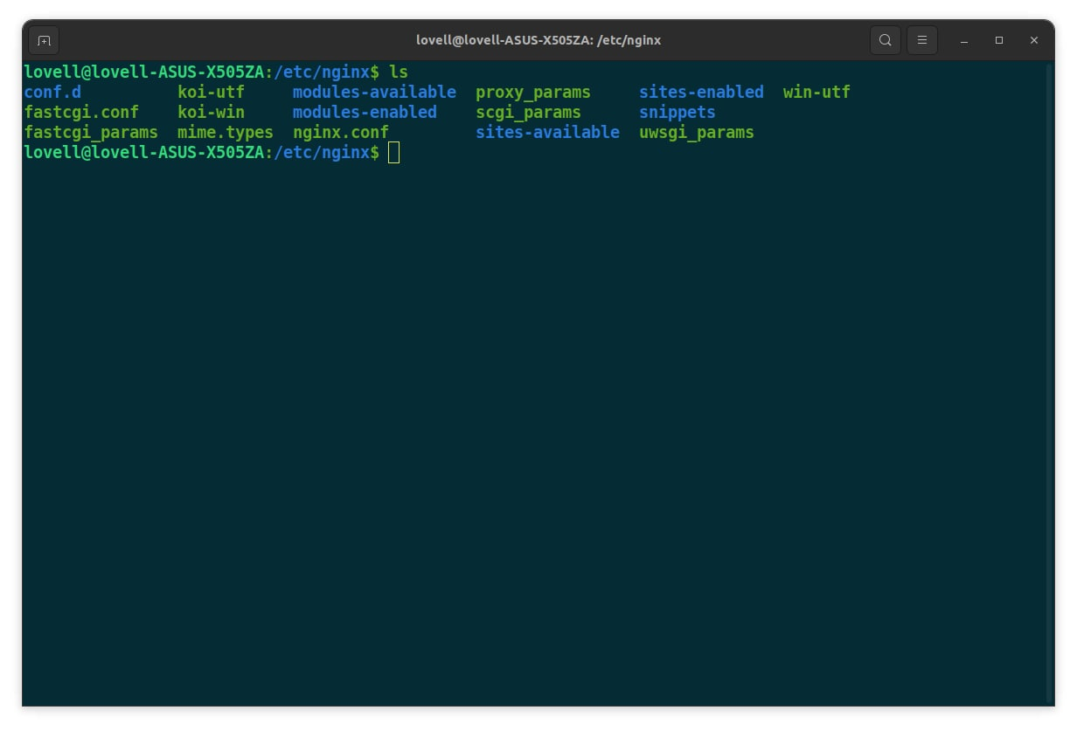
III. Shell command
Command syntax
The proxy configured on this screen is used for accessing the package repository and the snap store both in the installer environment and in the installed system.
Examples: ls - List files in current directory

Slide 26
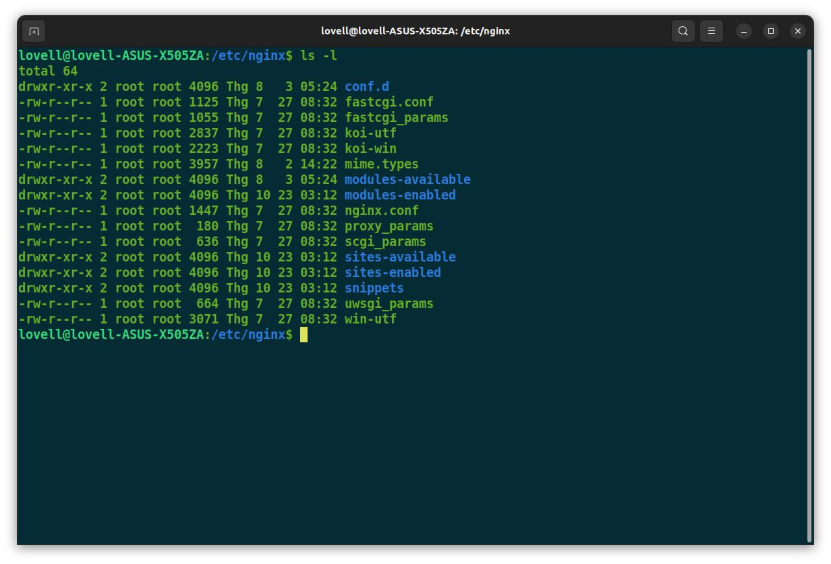
III. Shell command
Command syntax
The proxy configured on this screen is used for accessing the package repository and the snap store both in the installer environment and in the installed system.
Examples: ls -l - Lists files in “long” format

Slide 27
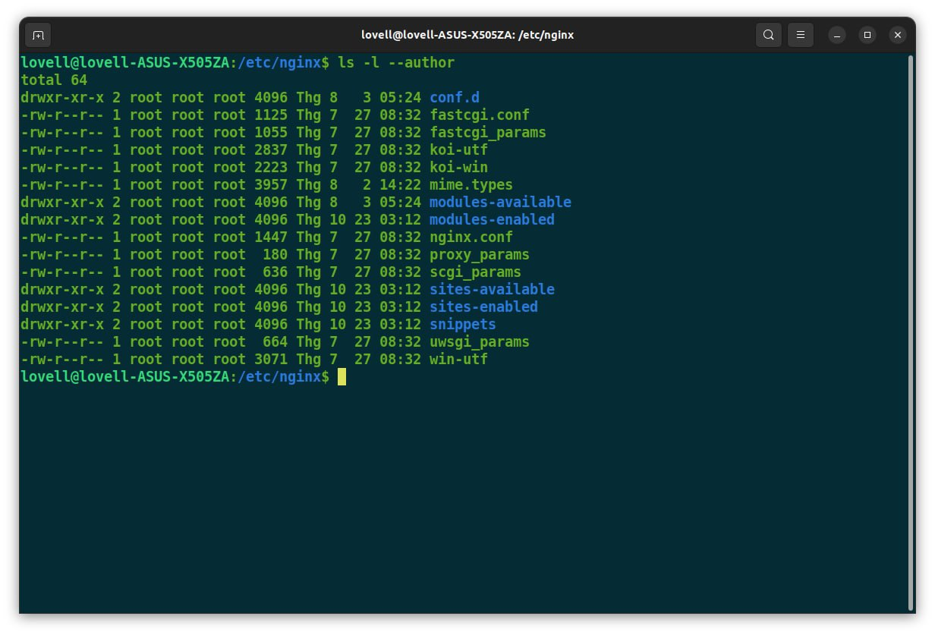
III. Shell command
Command syntax
The proxy configured on this screen is used for accessing the package repository and the snap store both in the installer environment and in the installed system.
Examples: ls -l --author - As above, print the author of each file

Slide 28
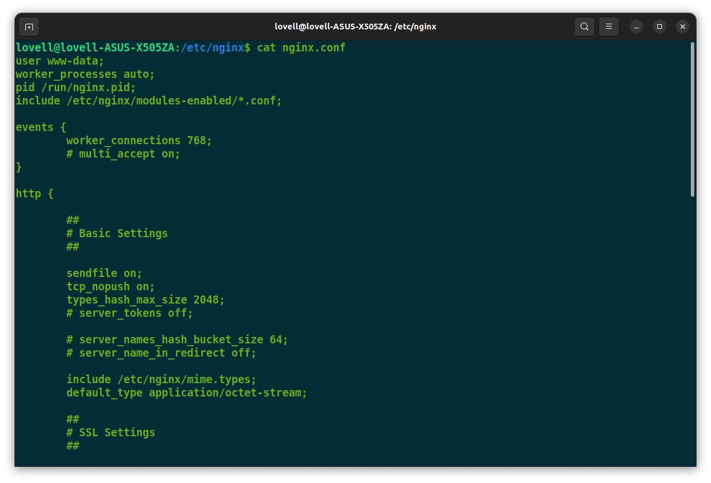
III. Shell command
Command syntax
The proxy configured on this screen is used for accessing the package repository and the snap store both in the installer environment and in the installed system.
Examples: cat filename - Show contents of a file

Slide 29
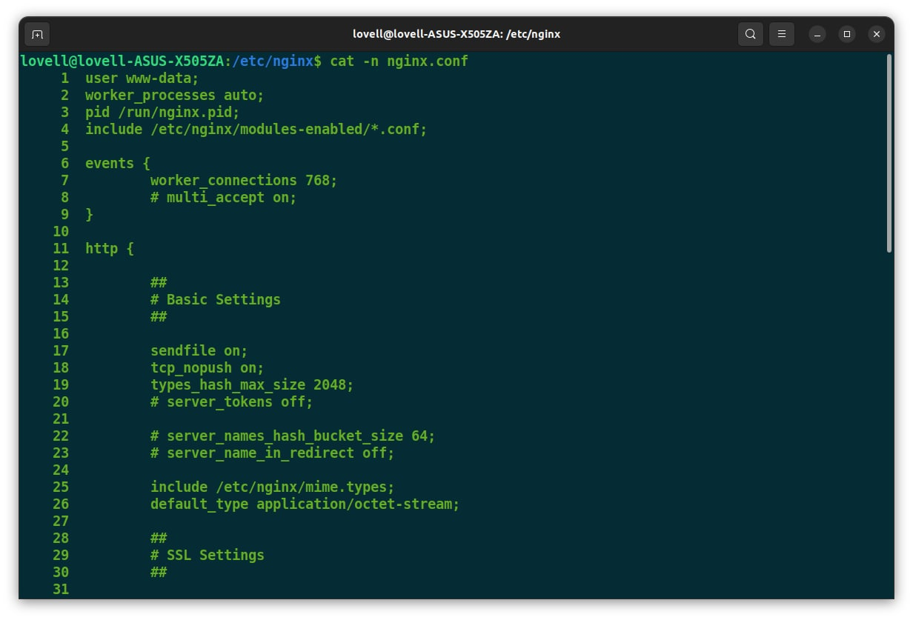
III. Shell command
Command syntax
The proxy configured on this screen is used for accessing the package repository and the snap store both in the installer environment and in the installed system.
Examples: cat -n filename - Show contents of a file, with line numbers

Slide 30
III. Shell command
Getting help
The proxy configured on this screen is used for accessing the package repository and the snap store both in the installer environment and in the installed system.
Using a command built-in help. Example: grep –h or grep –help
Man pages: To read a command man pages, type man command. Example: man ls or man man
To search for a particular word within a man page, type: /word. To quit from a man page, just type the Q key.
To search for a particular word in a command description, type: man –k word
Info pages. Example: info df

Slide 31
III. Shell command
Piping and redirection
The proxy configured on this screen is used for accessing the package repository and the snap store both in the installer environment and in the installed system.
The pipe character | is used to chain two or more commands together. The output of the first command is “piped” into the next command. For example: ls –al /usr/bin | less
In the example, the command ls will return a long listing of all files in /usr/bin. Because the output of this command is typically very long, we pipe the output to second command less, which displays the output one screen at a time.

Slide 32
III. Shell command
Piping and redirection
The proxy configured on this screen is used for accessing the package repository and the snap store both in the installer environment and in the installed system.
There are times when it is useful to save the output of a command to a file, instead of displaying it to the screen. The redirect character > is used to redirect commands output to a new file. If the file already exists, overwrite it. For example: ls -l /home/user1/MP3/*.mp3 > mp3files.txt. This command create a file that lists all the mp3 files in a directory.
The redirect character >> redirect output of a command to the end of an existing file. For example: ls -l /home/user1/extra/*.mp3 >> mp3files.txt. This command append outputs to the end of the original file.

Slide 33
III. Shell command
Informative command
The proxy configured on this screen is used for accessing the package repository and the snap store both in the installer environment and in the installed system.
The following commands are used to find out some information about the user or system.
Command | Description
ps | List currently running processes/programs
w | Show users logged on and what they are doing
id | Print your user id and group id
df | Report filesystem disk space usage
du | Disk usage in a particular directory

Slide 34
III. Shell command
Informative command
The proxy configured on this screen is used for accessing the package repository and the snap store both in the installer environment and in the installed system.
The following commands are used to find out some information about the user or system.
Command | Description
top | Displays realtime CPU processes in a full-screen GUI
free | Displays amount of free and used memory in the system
cat /proc/cpuinfo | Displays information about your CPU
cat /proc/meminfo | Displays information about current memory usage
uname –a | Prints system information (kernel version, machine type, ...)

Slide 35
III. Shell command
Utilities command
The proxy configured on this screen is used for accessing the package repository and the snap store both in the installer environment and in the installed system.
Here are some other commands that are useful to know.
Command | Description
clear | Clear the console
echo | Display text on the screen. Mostly useful when writing shell scripts
more | Display a file, or program output one page at a time
less | An improved replacement for the “more” command. Allows scrolling backwards as well as forwards
grep | Search for a pattern in a file or program output.
sort | Sort a file or program output
su | Switch User. Allows you to switch to another user's account temporarily. The default account to switch to is the root/superuser account. Examples: su - Switch the root account su - - Switch to root, and log in with root's environment

Slide 36
Linux Command

Slide 37
Linux command
FILE
VIM EDITOR

Slide 38
I. File
A file system is a logical collection of files on a partition or disk. A partition is a container for information and can span an entire hard drive if desired.
One file system per partition allows for the logical maintenance and management of differing file systems.
Everything in Unix is considered to be a file, including physical devices such as DVD-ROMs, USB devices, and floppy drives.

Slide 39
I. File
Directory structure
Unix uses a hierarchical file system structure, much like an upside-down tree, with root (/) at the base of the file system and all other directories spreading from there.
A Unix file system is a collection of files and directories that has the following properties:
It has a root directory (/) that contains other files and directories.
Each file or directory is uniquely identified by its name, the directory in which it resides, and a unique identifier, typically called an inode.
By convention, the root directory has an inode number of 2 and the lost+found directory has an inode number of 3. Inode numbers 0 and 1 are not used. File inode numbers can be seen by specifying the -i option to ls command.
It is self-contained. There are no dependencies between one file system and another.

Slide 40
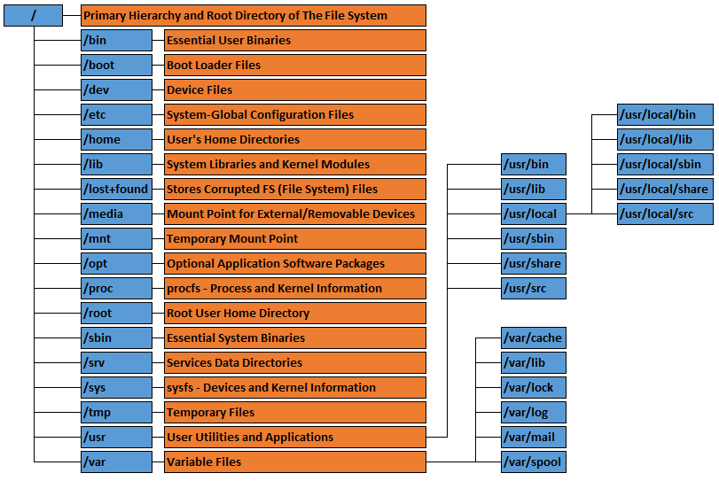
I. File
Linux directory layout
The directories have specific purposes and generally hold the same types of information for easily locating files. Following are the directories that exist on the major versions of Linux

Slide 41
I. File
Linux directory layout
Directory | Description
 | The nameless base of the filesystem. All other directories, files, drives, and devices are attached to this root. Commonly (but incorrectly) referred to as the “slash” or “/” directory. The “/” is just a directory separator, not a directory itself.
/bin | Essential command binaries (programs) are stored here (bash, ls, mount, tar, …)
/boot | Static files of the bootloader.
/dev | Device files. In Linux, hardware devices are acceessd just like other files, and they are kept under this directory.
/etc | Host-specific system configuration files.
/home | Location of users' personal home directories.
/lib | Essential shared libraries and kernel modules.

Slide 42
I. File
Linux directory layout
Directory | Description
/proc | Contains all processes marked as a file by process number or other information that is dynamic to the system
/root | The root (superuser) home directory
/sbin | Essential system binaries (fdisk, fsck, init, …)
/tmp | Holds temporary files used between system boots
/usr | The base directory for most shareable, read-only data (programs, libraries, documentation, and more).
/usr/bin | Most user programs are kept here (cc, find, du, ...)
/usr/include | Header files for compiling C programs.
/usr/lib | Libraries for most binary programs.

Slide 43
I. File
Linux directory layout
Directory | Description
/usr/local | “Locally” installed files. This directory only really matters in environments where files are stored on the network. Locally-installed files go in /usr/local/bin, /usr/local/lib, ...). Also often used for software packages installed from source, or software not officially shipped with the distribution.
/usr/sbin | Non-vital system binaries (lpd, useradd, ...)
/usr/share | Architecture-independent data (icons, backgrounds, documentation, terminfo, man pages, ...).
/usr/src | Program source code. E.g. The Linux Kernel, source RPMs, ...
/usr/X11R6 | The X Window System.
/var | Variable data: mail and printer spools, log files, lock files, etc.
/mnt | Used to mount other temporary file systems, such as usb.

Slide 44
I. File
Navigating the Linux filesystems
The following commands are used to navigate the system
Command | Description
pwd | Print Working Directory. Shows the current location in the directory tree.
cd | Change Directory. When typed all by itself, returns home directory.
cd path/to/dir | Change into the specified directory name.
cd ~ | Change into home directory.
cd .. | Move up one directory
ls | List the files in the current directory
ls -l | List files in “long” format and shows additional info about the file, such as ownership permissions, date, and size.
ls –a | List all files, include hidden files. Hidden files are files that name begin with a dot (.)
ls path/to/dir | List the files in the specified directory

Slide 45
I. File
Working with files and directories
These commands can be used to: find out information about files, display files, and manipulate them in other ways (copy, move, delete).
Command | Description
file | Find out what kind of file it is
cat | Display the contents of a text file on the screen.
head | Display the first few lines of a text file.
tail | Display the last few lines of a text file.
cp | Copies a file from one location to another.
mv | Moves a file to a new location, or renames it.
rm | Remove a file
mkdir | Make a new directory
rmdir | Remove a directory

Slide 46
I. File
Finding things
The following commands are used to find files. “ls” is good for finding files if you already know approximately where they are, but sometimes you need more powerful tools such as these:
Command | Description
which | Shows the full path of shell commands found in your path. For example, if you want to know exactly where the grep command is located on the filesystem, you can type which grep. The output should be something like: /bin/grep
whereis | Locates the program, source code, and manual page for a command (if all information is available). For example, to find out where ls and its man page are, type: whereis ls. The output will look something like: ls: /bin/ls /usr/share/man/man1/ls.1.gz
locate | The locate command is a Unix utility used for quickly finding files and directories. The command is a more convenient and efficient alternative to the find command, which is more aggressive and takes longer to complete the search.
find | A very powerful command, but sometimes tricky to use. It can be used to search for files matching certain patterns, as well as many other types of searches.

Slide 47
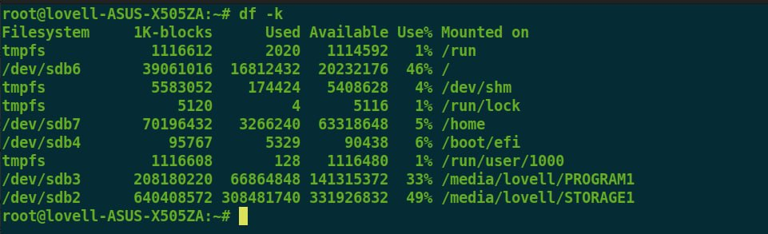
I. File
The df command
The first way to manage your partition space is with the df (disk free) command. The command df -k displays the disk space usage in kilobytes, as shown below:

Slide 48
I. File
The df command
The df -k output is generally the same on all Unix systems. Here's what it usually includes:
Column | Description
Filesystem | The physical file system name
1K-blocks | Total kilobytes of space on the storage medium
Used | Total kilobytes of space used by files
Available | Total kilobytes of space available for user
Use% | Percentage of total space used by files
Mounted on | Where the file system is mounted on

Slide 49
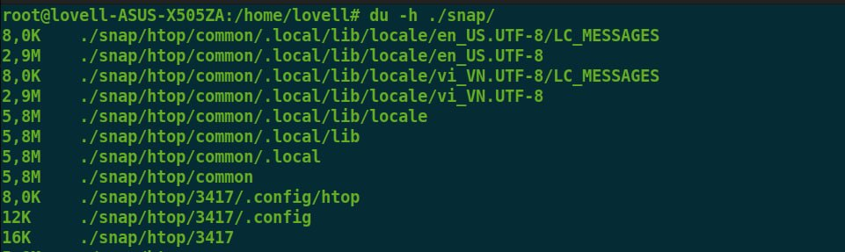
I. File
The du command
The du (disk usage) command summarizes disk usage on a particular directory.
This command is helpful if you want to determine how much space a particular directory is taking. The following command displays number of blocks consumed by each directory. A single block may take either 512 bytes or 1 kilobyte depending on your system.
The –h option makes the output easier to comprehend.

Slide 50
II. Vim editor
Introduction
Vim is acronym for Vi IMproved. It is free and open source text editor written by Bram Moolenaar. It was first released in 1991 for UNIX variants and its main goal was to provide enhancement to the Vi editor, which was released way back in 1976.
Vim is considered as clone Vi editor. Like Vi, it is also command centric editor. One of the advantage of learning Vim is – it is available everywhere. Take any UNIX variant like Linux, Mac, HP-UX, AIX and many more, Vim is there by default. Vim traditionally does not have GUI but now there is separate installer called gVim which provides GUI.

Slide 51
II. Vim editor
Features
This section discusses some of the important features of Vim:
Its memory footprint is very low
It is command centric. You can perform complex text related task with few commands
It is highly configurable and uses simple text file to store its configuration
There are many plug-in available for Vim. Its functionality can be extended in great manner using these plug-in
It supports multiple windows. Using this feature screen can be split into multiple windows
Same as multiple windows, it also supports multiple buffers
It supports multiple tabs which allows to work on multiple files
It supports recording features which allows to record and play Vim commands in repeated manner

Slide 52
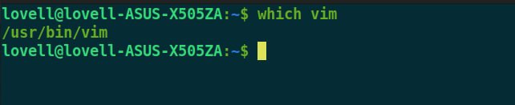
II. Vim editor
Installation
Execute these commands in the terminal:
sudo apt update
sudo apt install vim
To ensure vim is correctly installed, execute this command: which vim. It should print the location of Vim binary.

Slide 53
II. Vim editor
Configuration
Vim stores its configuration in simple text file namely .vimrc and it is located under home directory of user.
Navigate to home directory and create a new file namely .vimrc. Enter the following line and save it: set nu
Now Vim will show line numbers when file is opened. More options to this file is available latter on.

Slide 54
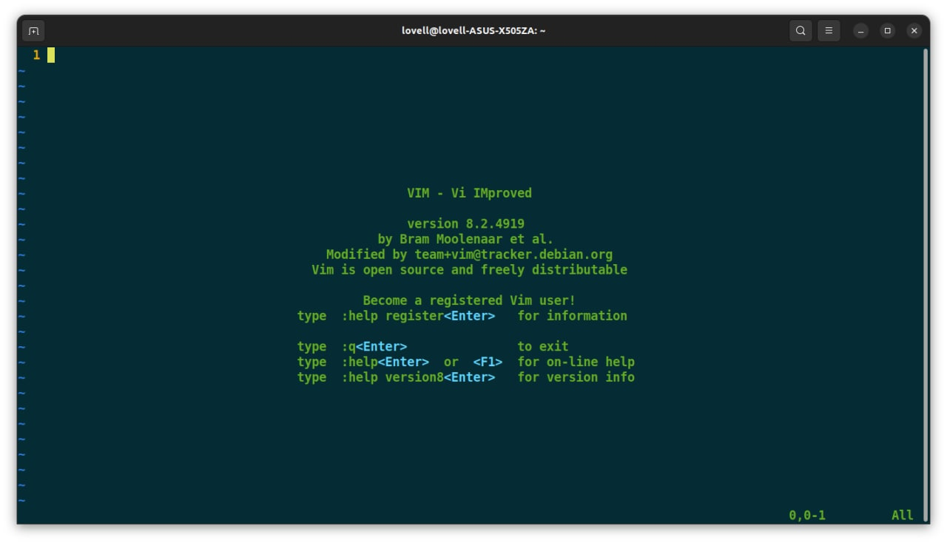
II. Vim editor
Start Vim
Perform following steps to start and quit Vim from terminal:
Open terminal and enter the command: vim. It will open Vim in terminal as follows
To close this, press Esc key then type :q. The command will be shown in bottom left corner of the editor

Slide 55
II. Vim editor
Vim modes
Vim supports multiple modes. This section discusses some of the important modes which will be used on day-to-day basis.
Command mode: This is the default mode in which Vim starts. We can enter editor commands in this mode and use variety of commands in this mode like copy, paste, delete, replace and many more.
Insert mode: This mode is used to enter/edit text. To switch from default command to insert mode press i key. It will show current mode in bottom left corner of editor. Use Esc key to switch back to command mode from this mode.
Command line mode: This mode is also used to enter commands. Commands in this mode starts with colon(:). To switch from command mode to this mode just type colon. To switch from insert mode to this mode press Esc and type colon.
Visual mode: In this mode we can visually select text and run commands on selected sections. To switch from command mode to visual mode type v. To switch from any other mode to visual mode first switch back to command mode by pressing Esc, then type v.

Slide 56
II. Vim editor
Create new file
Perform below steps to create and save new file:
Open Vim: vim
Type following command in Vim. It will reload the file if already exist: :edit newfile.txt
Switch to insert mode: i
Enter some text
Switch back to command mode: esc
Save changes to file: :w
Now newfile.txt file will be created.
Quit Vim: :q

Slide 57
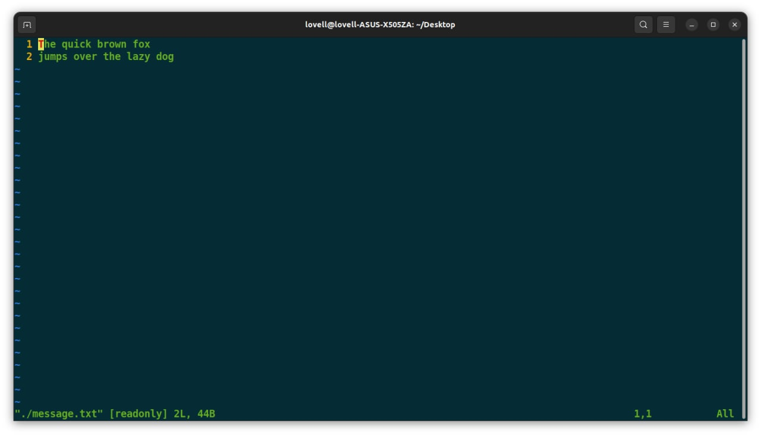
II. Vim editor
Open file in read-only mode
Use –R option to open file in read-only mode. Alternatively you can use view command
vim –R ./message.txt
view ./message.txt

Slide 58
II. Vim editor
Edit existing file
Perform below steps to edit existing file:
Open file in Vim: vim message.txt
Switch to insert mode: i
Enter some text
Switch back to command mode: esc
Quit without saving changes: :q! OR
Save changes and quit editor: :wq

Slide 59
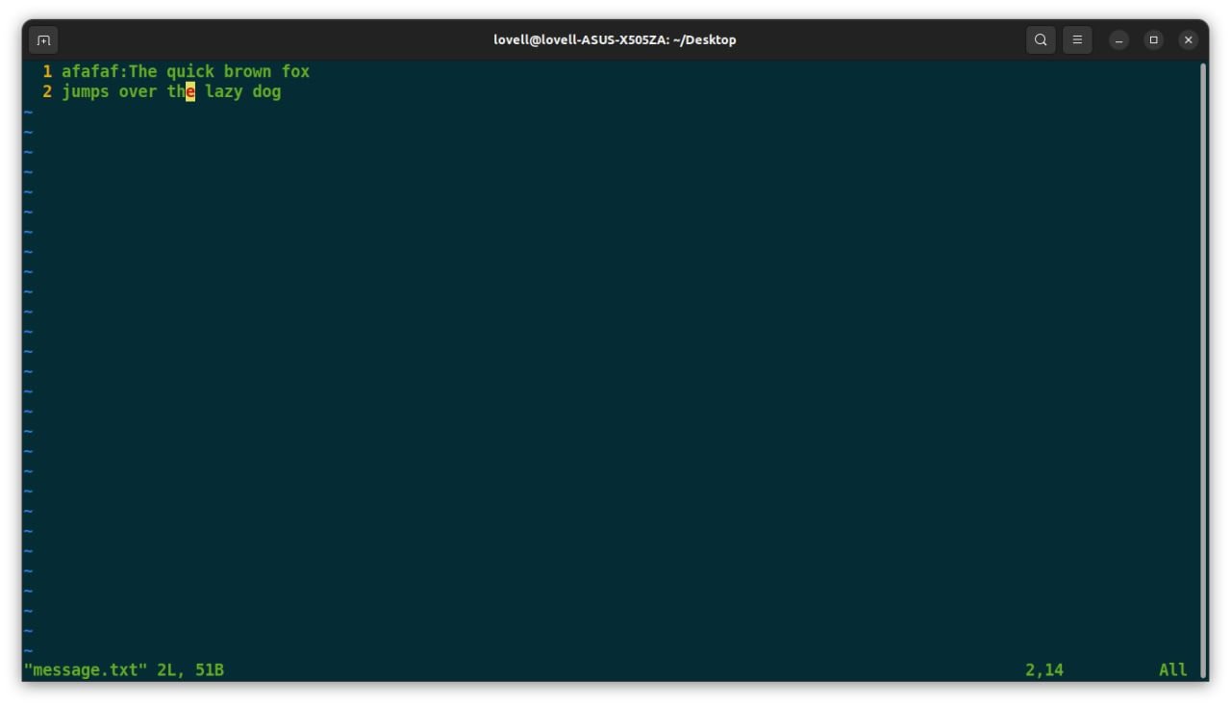
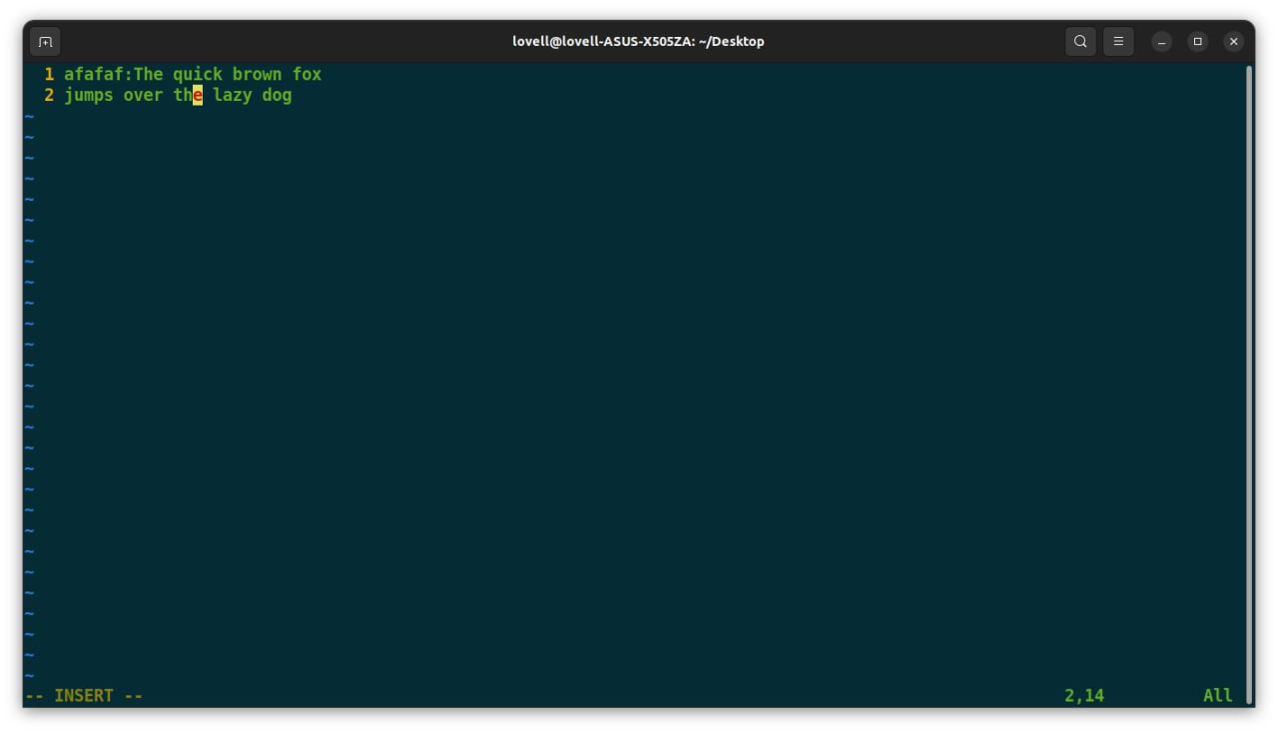
II. Vim editor
Insert text before cursor
To insert text before cursor perform following steps:
Move cursor to desired position
Switch to insert mode: i

Slide 60

II. Vim editor
Insert text at the beginning of line
Suppose you are in the middle of line and ant to insert text at the beginning of current line then perform following steps:
Switch to command mode: Esc
Switch to insert mode: I

Slide 61
II. Vim editor
Append text after cursor
To append text after cursor perform following steps:
Move cursor to desired position
Switch to append mode. This action will move cursor next by one position and switch Vim in insert mode.: a

Slide 62
II. Vim editor
Basic navigation
In basic navigation we can navigate to left, right, up and down by position. Below
commands can be used for this:
Command | Description
h | Move cursor to left by one position
l | Move cursor to right by one position
k | Move cursor to up direction by one position
j | Move cursor to down direction by one position
To perform multi-position navigation use number before these commands. For instance 10j move cursor 10 line below the current line

Slide 63
II. Vim editor
Basic navigation
In addition, below commands also perform some useful navigation.
Command | Description
0 | Move cursor to the beginning of current line
$ | Move cursor to the end of current line
Ctrl + f | Scroll down entire page
Ctrl + b | Scroll up entire page

Slide 64
II. Vim editor
Line navigation
Below command can be used to navigate to specific line:
Command | Description
:n | Jump to the Nth line
:0 | Move cursor to the start of file
:$ | Move cursor to the end of file

Slide 65
II. Vim editor
Word navigation
Following commands can be used for word navigation:
Command | Description
w | Move cursor to the beginning of the next word
e | Move cursor to the end of the current word
b | Move cursor to the beginning of the previous word

Slide 66
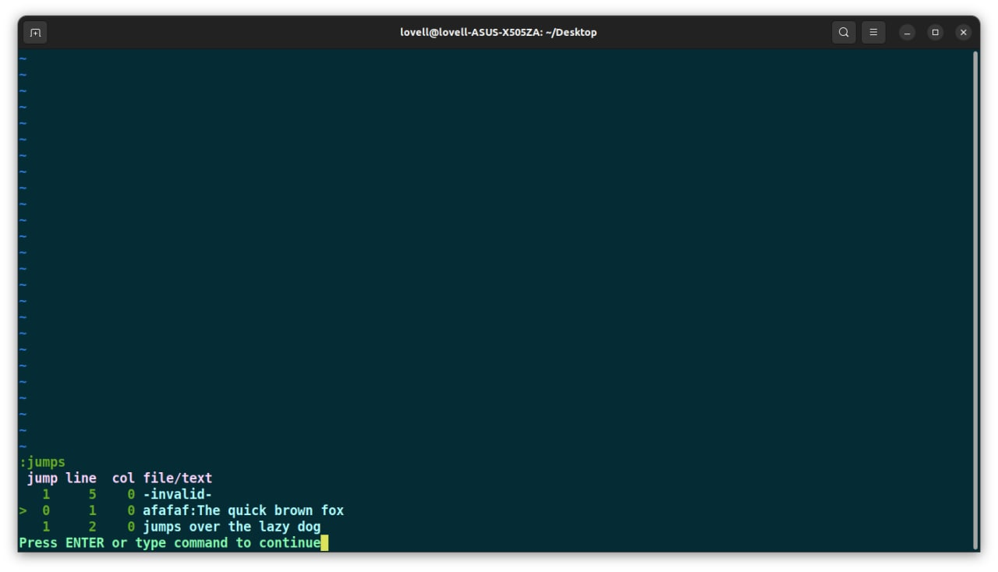
II. Vim editor
Using jumps
Vim keeps track of your navigation using a jump list. You can go backward and forward
through that list.
The jump list keeps tracks of all the places you’ve been to by tracking file name, line
number and column number. To view jump list execute following command: :jumps

Slide 67
II. Vim editor
Buffer
Buffer is temporary memory used by Vim. When we open a file in editor, Vim loads its contents from disk drive.
These contents are stored in memory (RAM) whenever we edit a file we are actually editing file from buffer. Once we finish editing and save file that time only buffer contents are transferred to appropriate file.

Slide 68
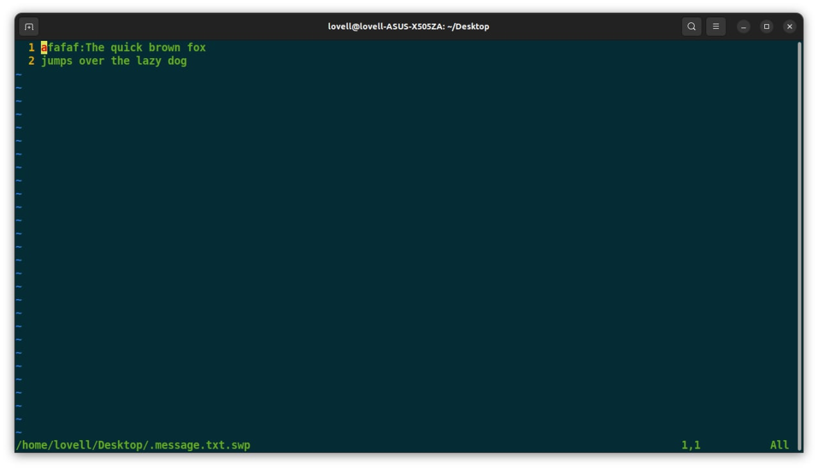
II. Vim editor
Swap
Swap area is a file created by Vim to store buffer contents periodically. While editing file our changes may be lost because of any reasons and Vim provides swap files to provide data recovery.
To get actual name of swap file execute following command: :swapname

Slide 69
II. Vim editor
Cut, Copy and Paste actions
Vim provides following commands to perform these actions:
Command | Description
x | Delete character from cursor position
X | Delete previous character from cursor position
y | Copy single character from cursor position
p | Paste character after cursor position
P | Paste character before cursor position

Slide 70
II. Vim editor
Multi-position command
We can use cut, copy and paste commands with words and sentences as well.
Command | Description
dw | Delete word from cursor position
D | Delete entire line from cursor position
dd | Delete entire line
Y | Copy entire line
yy | Copy entire line
To perform multi-line/multi-word actions just use numbers with command. You can use this syntax with other commands as well. For instance, to delete 3 words use: 3dw

Slide 71
II. Vim editor
Undo
We can undo single or multiple actions. To perform one time undo action execute: u
To perform multiple undo action, use number with same command. For instance, below command will undo last 3 actions: 3u
To undo all execute following command: U
Redo
Execute any of the command to perform redo action: Ctrl + r | :red

Slide 72
II. Vim editor
Plugin management
Vim provides various plugins managers but we’ll be doing all these steps manually for better understanding.
Install plugin: To install any plugin, follow these steps
1. Create .vim/bundle directory in user’s home directory
2. Copy plugin inside this directory
3. Set runtimepath in Vim

Slide 73
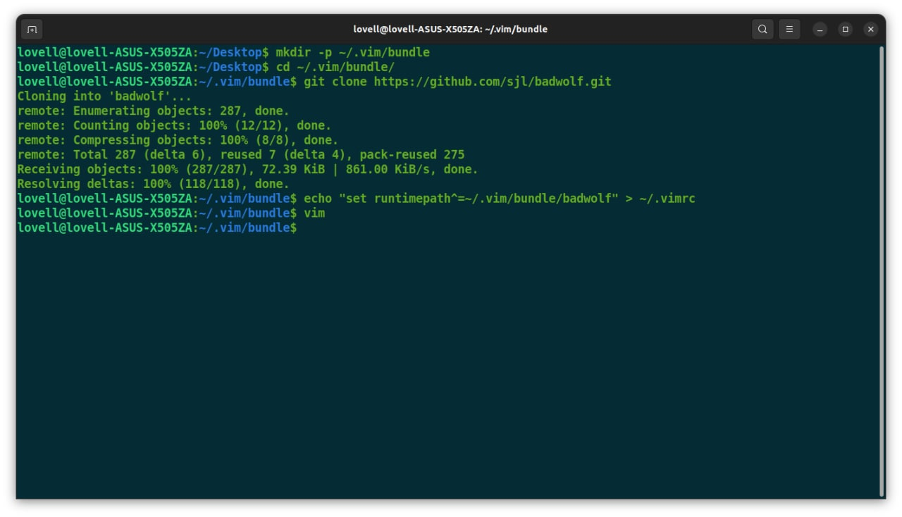
II. Vim editor
Plugin management
The following install badwolf plugin in Vim. It is a color scheme for Vim:
mkdir -p ~/.vim/bundle
cd ~/.vim/bundle/
git clone https://github.com/sjl/badwolf.git
echo "set runtimepath^=~/.vim/bundle/badwolf" > ~/.vimrc

Slide 74
II. Vim editor
Plugin management
Some useful plugins:
Name | Description
DumpX | Disassemble C/C++ code
awk.vim | Indenting for AWK script
Pathogen | Vim package manager
git-switcher.vim | Automatically save and load vim session based on switching of git branch
Pyflakes | Provide liniting for python files

Slide 75
Shell script

Slide 76
Shell script
REGEX
SHELL SCRIPT

Slide 77
I. Regular expression
What is a regular expression (or regex)?
Regular expressions are defined as a sequence of characters that define a search pattern.
They are available in basically every programming language, and most commonly used for string matches in conditionals that are too complicated for simple logical comparisons.

Slide 78
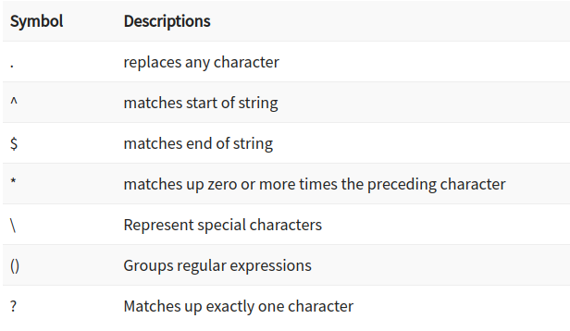
I. Regular expression
What is a regular expression (or regex)?
Some basic regular expressions

Slide 79
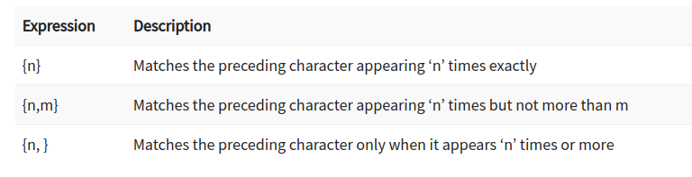
I. Regular expression
What is a regular expression (or regex)?
Interval expressions

Slide 80
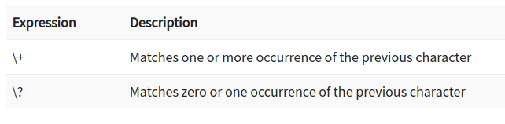
I. Regular expression
What is a regular expression (or regex)?
Extended expressions

Slide 81
I. Regular expression
Grep
grep (global regular expression print) is a command-line utility for searching plain-text data sets for lines that match a regular expression.
This seemingly trivial program is extremely powerful; its ability to sort input based on complex rules makes it a popular link in many command chains.

Slide 82
I. Regular expression
Basic usage
Search for every lines that contain the word needed:
grep <some-words> /path/to/file

Slide 83
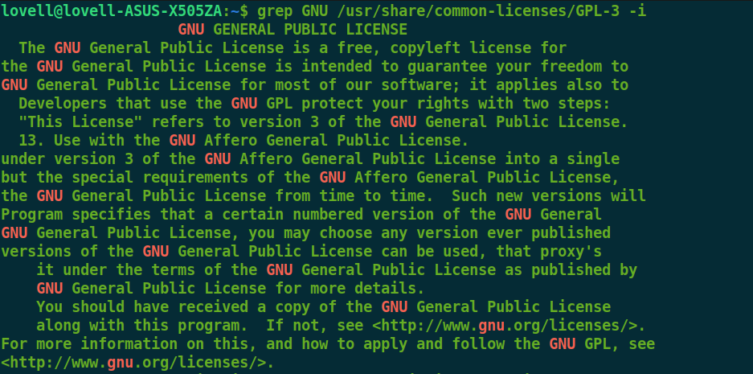
I. Regular expression
Grep common options
By default, grep will search for the exact specified pattern within the input file and return the lines it finds. We can make this behavior more useful by adding some optional flags to grep.
-i or --ignore-case to search for both upper and lower-case variations.

Slide 84
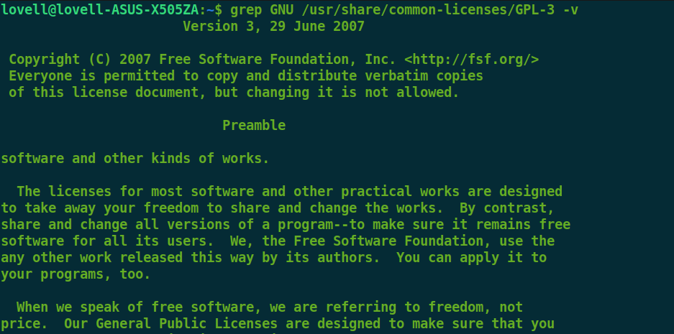
I. Regular expression
Grep common options
-v or --inverted-match to find all lines that do NOT contain a specified pattern.

Slide 85
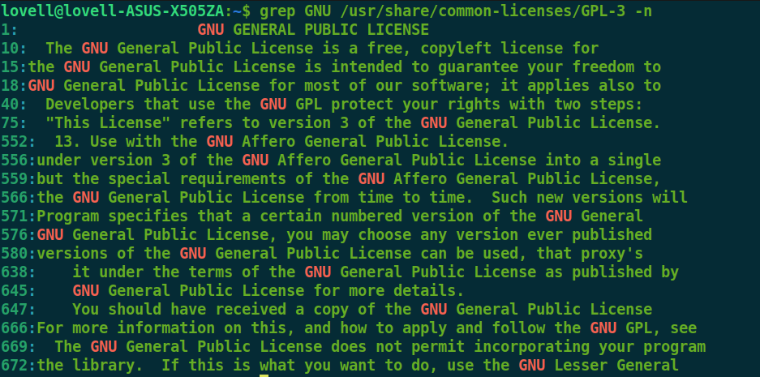
I. Regular expression
Grep common options
-n or --line-number to display the line number that the matches occur on.

Slide 86
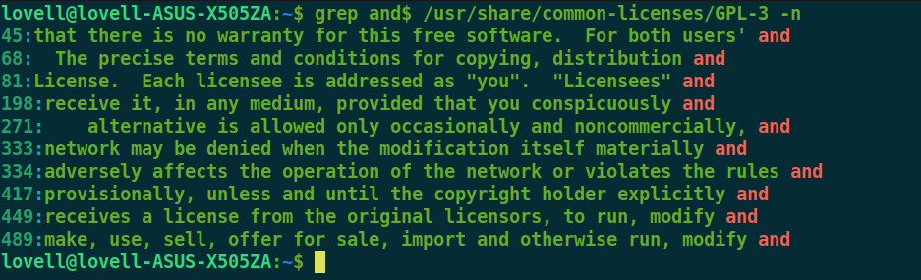
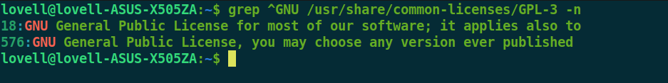
I. Regular expression
Grep with regular expression
Anchor matches: Anchors are special characters that specify where in the line a match must occur to be valid.

Slide 87
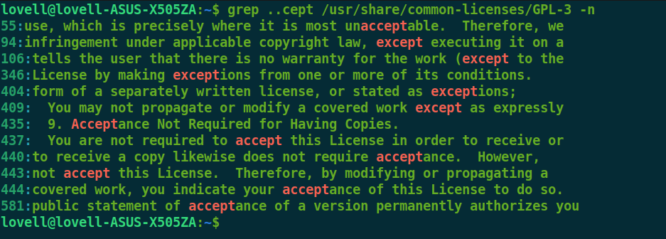
I. Regular expression
Grep with regular expression
Matching any character

Slide 88
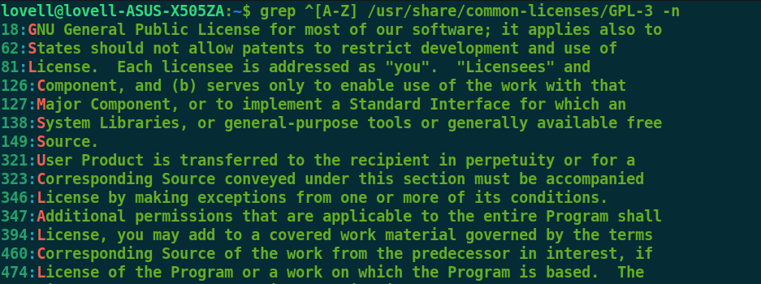
I. Regular expression
Grep with regular expression
Bracket expression

Slide 89
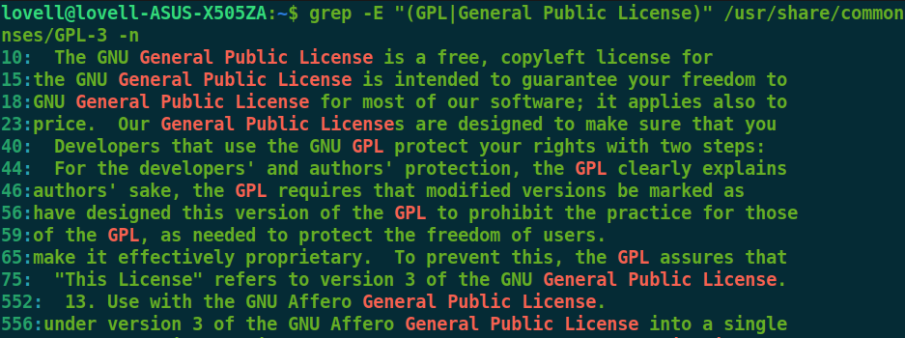
I. Regular expression
Grep extended regular expression
The grep command supports a more extensive regular expression language by using the -E flag or by calling the egrep command instead of grep.
These options open up the capabilities of “extended regular expressions”. Extended regular expressions include all of the basic meta-characters, along with additional meta-characters to express more complex matches.

Slide 90
II. Shell script
A shell is a command-line interpreter and typical operations performed by shell scripts include file manipulation, program execution, and printing text.
A shell script is a computer program designed to be run by the Unix/Linux shell which could be one of the following:
The Bourne Shell (sh shell)
The C Shell (csh or tcsh)
The Z Shell (zsh)
The GNU Bourne-Again Shell (bash)

Slide 91
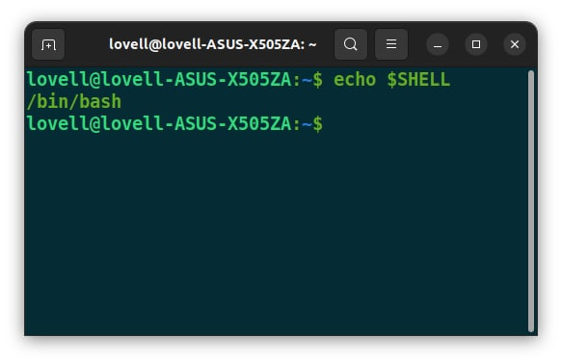
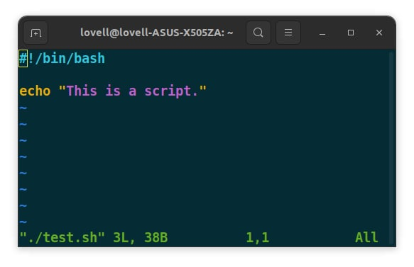
II. Shell script
Example script
All shell scripts should have the .sh extension. Before you add commands to the script, you need to alert the system that a shell script is being started. This is done using the hashbang construct: #!/bin/bash. This tells the system that the commands that follow are to be executed by the bash shell.

Slide 92
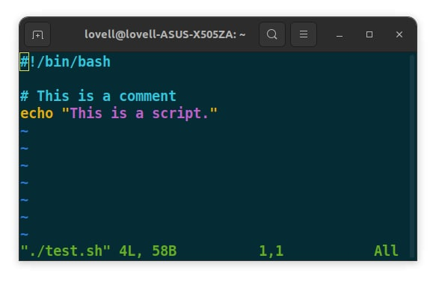
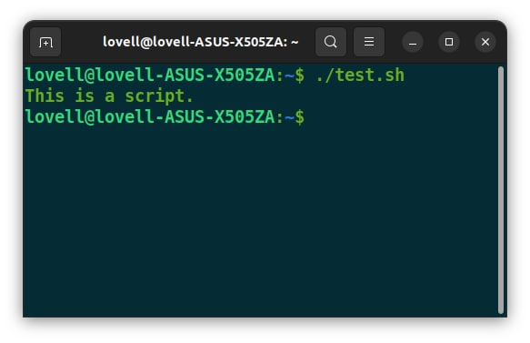
II. Shell script
Execute a script
You can put comments in a script after # symbol.
To make the script executable, run this command: chmod +x [filename]
The script is now ready to be executed: ./filename.sh

Slide 93
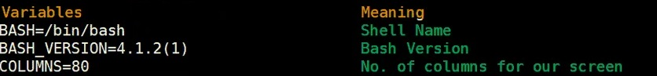
II. Shell script
Variables
A variable is a character string to which we assign a value. The value assigned could be a number, text, filename, device, or any other type of data. A variable is nothing more than a pointer to the actual data. The shell enables us to create, assign, and delete variables.
Example:

Slide 94
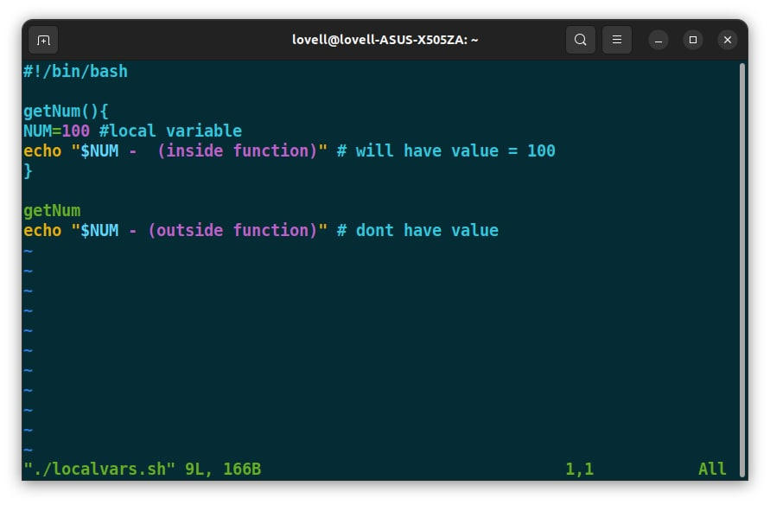
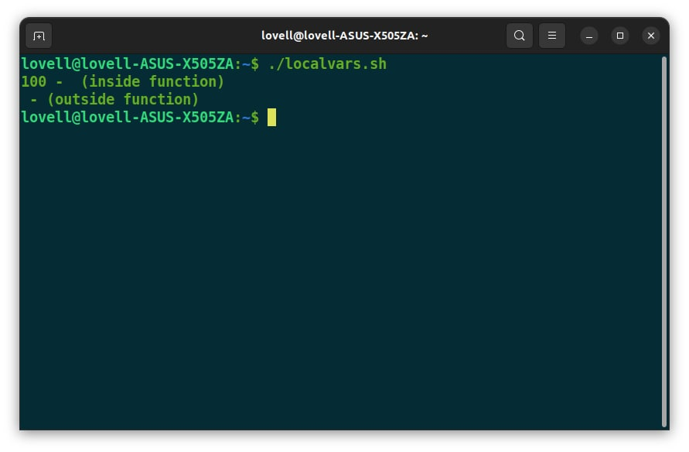
II. Shell script
Variable types
When a shell is running, three main types of variables are present.
Local Variables: A local variable is a special type of variable which has its scope only within a specific function or block of code. Local variables can be overridden by the same variable name in a larger scope.

Slide 95
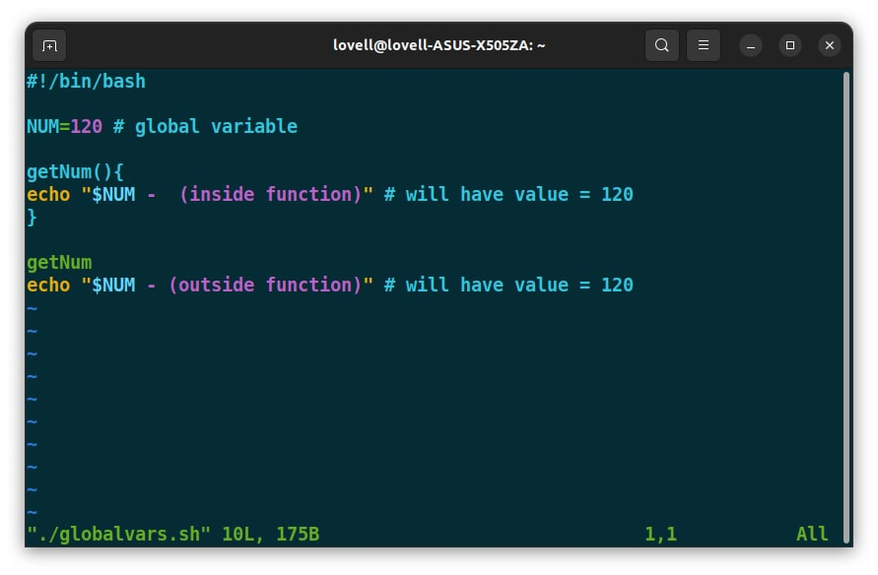
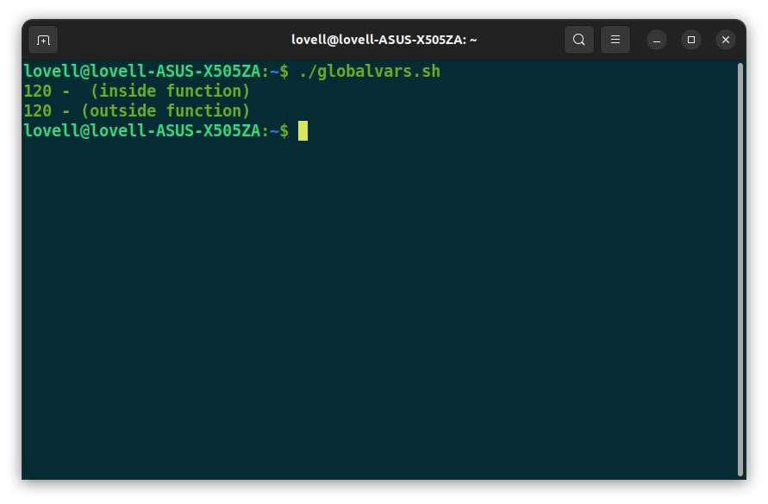
II. Shell script
Variable types
Global Variables: A global variable is a variable with global scope. It is accessible throughout the program. Global variables are declared outside any block of code or function.

Slide 96


II. Shell script
Variable types
Shell Variables: Shell variables are created and maintained by Linux shell itself. These variables are required by the shell to function properly. Example:

Slide 97
II. Shell script
Variable names
Variable names: The name of a variable can contain only letters (a-z and A-Z), numbers (0 to 9) and the underscore character ( _). By convention, Unix shell variables will have their names in UPPERCASE.
Valid names: TOKEN, VAR_1, _NAME, ..
Invalid names: 2_VAR, -VARIABLE, VAR1-VAR2, VAR_A!, ..

Slide 98
II. Shell script
Define and access variable
Define variables: Variables of this type are called scalar variables. A scalar variable can hold only one value at a time. Shell enables us to store any value we want in a variable.
variable_name=variable_value
Example: A=3, _NAME=linux
Access variables: To access the value stored in a variable, prefix its name with the dollar sign ($)
Example: $_NAME, $A,..
Unsetting: Unsetting or deleting a variable directs the shell to remove the variable from the list of variables that it tracks. Once you unset a variable, you cannot access the stored value in the variable.
Example: unset _NAME

Slide 99

II. Shell script
Using arrays
Shell supports a different type of variable called an array variable. This can hold multiple values at the same time. Arrays provide a method of grouping a set of variables.
Array initialization for bash shell: array_name=(value1 value2 ... valueN)
Access array values: ${array_name[index]}

Slide 100
II. Shell script
Basic operations
Some basic operations in Bourne shell (default shell)
Arithmetic Operators
Relational Operators
Boolean Operators
String Operators
File Test Operators

Slide 101

II. Shell script
Arithmetic operations
Bourne shell (default shell) didn't originally have any mechanism to perform simple arithmetic operations but it uses external programs, either awk or expr.

Slide 102

II. Shell script
Arithmetic operations
Example:

Slide 103

II. Shell script
Relational operations
Bourne Shell supports the following relational operators that are specific to numeric values. These operators do not work for string values unless their value is numeric.

Slide 104

II. Shell script
Relational operations
Example:

Slide 105

II. Shell script
Boolean operations
The following boolean operators are supported by the Bourne Shell.

Slide 106

II. Shell script
String operations
The following string operators are supported by the Bourne Shell.

Slide 107

II. Shell script
File test operations
Bourne shell has a few operators that can be used to test various properties associated with a Unix file.

Slide 108
II. Shell script
Conditional statements
Unix Shell supports conditional statements which are used to perform different actions based on different conditions.
The if..else statement:
If..else statements are useful decision-making statements which can be used to select an option from a given set of options. Unix Shell supports following forms of if…else statement:
if...fi statement
if...else...fi statement
if...elif...else...fi statement
Most of the if statements check relations using relational operators discussed in the previous chapter.

Slide 109

II. Shell script
Conditional statements
Example:

Slide 110
II. Shell script
Conditional statements
Unix Shell supports conditional statements which are used to perform different actions based on different conditions.
The case..esac statement
You can use multiple if..else statements to perform a multiway branch. However, this is not always the best solution, especially when all of the branches depend on the value of a single variable.
Unix Shell supports case..esac statement which handles exactly this situation, and it does so more efficiently than repeated if..else statements.
There is only one form of case..esac statement: case..esac

Slide 111

II. Shell script
Conditional statements
Example:

Slide 112
Linux server

Slide 113
Linux server
INSTALL DATABASE (MYSQL)
FTP CONFIGURATION
SSH CONFIGURATION
WEBSERVER INSTALL (NGINX)

Slide 114
I. Install database (MySQL)
MySQL is an open-source database management system, commonly installed as part of the popular LAMP (Linux, Apache, MySQL, PHP/Python/Perl) stack. It implements the relational model and uses Structured Query Language (better known as SQL) to manage its data.
Prerequisites: One Ubuntu 20.04 server with a non-root administrative user and a firewall configured with UFW.

Slide 115

I. Install database (MySQL)
Step 1: Installing MySQL
On Ubuntu 20.04, you can install MySQL using the APT package repository.
To install it, update the package index on the server: sudo apt update
Then install the mysql-server package: sudo apt install mysql-server
Ensure that the server is running using the systemctl start command: sudo systemctl start mysql.service

Slide 116

I. Install database (MySQL)
Step 2: Configuring MySQL
You’ll want to run the DBMS’s included security script. This script changes some of the less secure default options for things like remote root logins and sample users.
Run the security script with sudo: sudo mysql_secure_installation

Slide 117

I. Install database (MySQL)
Step 2: Configuring MySQL
This will take you through a series of prompts where you can make some changes to your MySQL installation security options. The first prompt will ask whether you’d like to set up the Validate Password Plugin, which can be used to test the password strength of new MySQL users before deeming them valid.
If you elect to set up the Validate Password Plugin, any MySQL user you create that authenticates with a password will be required to have a password that satisfies the policy you select.

Slide 118

I. Install database (MySQL)
Step 2: Configuring MySQL
The next prompt will be to set a password for the MySQL root user. Enter and then confirm a secure password of your choice:

Slide 119

I. Install database (MySQL)
Step 2: Configuring MySQL
From there, you can press Y and then ENTER to accept the defaults for all the subsequent questions. This will remove some anonymous users and the test database, disable remote root logins, and load these new rules so that MySQL immediately respects the changes you have made.

Slide 120
I. Install database (MySQL)
Step 3: Creating a dedicated MySQL user and granting privileges
Upon installation, MySQL creates a root user account which you can use to manage your database. This user has full privileges over the MySQL server, meaning it has complete control over every database, table, user, and so on. Because of this, it’s best to avoid using this account outside of administrative functions.
Login as root: mysql -u root -p
Create new user: CREATE USER username@'localhost' IDENTIFIED WITH mysql_native_password BY 'password';

Slide 121
II. FTP configuration
FTP stands for File Transfer Protocol. It is similar to HTTP (HyperText Transfer Protocol), in that it specifies a language for transferring data over a network.
Prerequisites: non-root administrative user.

Slide 122

II. FTP configuration
Step 1: Install vsftpd Server on Ubuntu
Update the package index on the server: sudo apt update
Then install the vsftpd package: sudo apt install vsftpd
Ensure that the server is running using the systemctl start command: sudo systemctl start vsftpd

Slide 123
II. FTP configuration
Step 2: Create FTP User
Before making any changes, make sure to back up your configuration files. Create a backup copy of the default configuration file: sudo cp /etc/vsftpd.conf /etc/vsftpd.conf_default
Create a new FTP user: sudo useradd -m testftpuser
sudo passwd testftpuser
The system should ask you to create a password for the new account.

Slide 124

II. FTP configuration
Step 4: Connect to FTP Server
Log in using the account and password you just set. You should now be successfully logged in to your FTP server: sudo ftp <server-name>

Slide 125
III. SSH configuration
Secure Shell (SSH) is a network protocol used for a secure connection between a client and a server. Each interaction between the server and a client is encrypted. Enabling SSH will allow you to connect to your system remotely and perform administrative tasks. You’ll also be able to securely transfer files via scp and sftp.
Prerequisites: non-root administrative user.

Slide 126

III. SSH configuration
Step 1: Install openssh server on Ubuntu
Update the package index on the server: sudo apt update
Then install the openssh-server package: sudo apt install openssh-server
Ensure that the server is running using the systemctl start command: sudo systemctl start ssh

Slide 127
III. SSH configuration
Step 2: Configure UFW to Allow SSH Traffic
UFW that comes standard with Ubuntu will block SSH traffic by default. Open ports 80 for SSH traffic: sudo ufw allow ssh

Slide 128
IV. Websever install (Nginx)
Nginx is one of the most popular web servers in the world and is responsible for hosting some of the largest and highest-traffic sites on the internet. It is a lightweight choice that can be used as either a web server or reverse proxy.
Prerequisites: non-root administrative user.

Slide 129

IV. Websever install (Nginx)
Step 1 – Installing Nginx
Update the package index on the server: sudo apt update
Then install the nginx package: sudo apt install nginx
Ensure that the service is running using the systemctl start command: sudo systemctl start nginx

Slide 130

IV. Websever install (Nginx)
Step 2 – Adjusting the Firewall
There are three profiles available for Nginx:
Nginx Full: This profile opens both port 80 (normal, unencrypted web traffic) and port 443 (TLS/SSL encrypted traffic)
Nginx HTTP: This profile opens only port 80 (normal, unencrypted web traffic)
Nginx HTTPS: This profile opens only port 443 (TLS/SSL encrypted traffic)

Slide 131
IV. Websever install (Nginx)
Step 2 – Adjusting the Firewall
Before testing Nginx, the firewall software needs to be adjusted to allow access to the service. Nginx registers itself as a service with UFW upon installation, making it straightforward to allow Nginx access.
It is recommended that you enable the most restrictive profile that will still allow the traffic you’ve configured. For example, to allow traffic on port 80: sudo ufw allow 'Nginx HTTP'

Slide 132

IV. Websever install (Nginx)
Step 3 – Checking your Web Server
At the end of the installation process, the web server should already be up and running.
You can access the default Nginx landing page to confirm that the software is running properly by navigating to your server’s IP address. When you have your server’s IP address, enter it into your browser’s address bar: http://your_server_ip. You should receive the default Nginx landing page:

Slide 133
Thank you for your attention

